Slide 1

Super Happy Dev Day
Mobile Awesomesauce

Slide 2

Introductions
Hi, my name is Dayel Ostraco
Mobile Evangelist and Señor Tech Lead for SPARC
My site - http://dayelostra.co
GitHub - http://github.com/dostraco
Presentation Stuffs – Add GitHub url here.
Email – dayel.ostraco@sparcedge.com
Notes:
Embrace mobile constraints to focus and prioritize the services we’re designing and building.
Use mobile capabilities to innovate the complete customer experience.
Take what we know about designing for the web and start thinking differently about mobile organization, actions, inputs, and layout.

Slide 3
What we’ll cover
What mobile can do? (and some fun stats)
How does Mobile Development differ from standard development?
Mobile Development Strategies
Nitty Gritty Android Phone Gap Lab

Slide 4
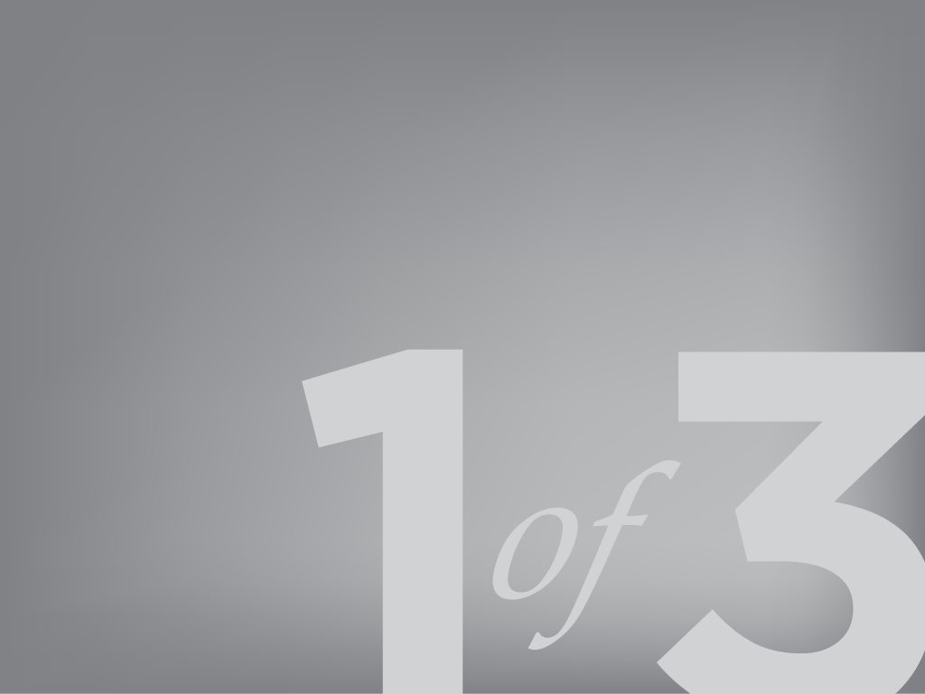
Mobile Capabilities
“The era of mobile computing… is outpacing both the PC revolution of the 1980s and the Internet Boom of the 1990s.” - Charles Newark-French

Slide 5
Sensory Perception
Touch
Camera(s)
Gyroscope
Location (GPS, WiFI, Carrier Tower)
Compass
Audio
Bluetooth Communication

Slide 6
Sensory Overload?
Near Field Communication
Ambient Light
Proximity
Barometer
Thermometer
Augmented Reality
Haptic Feedback

Slide 7
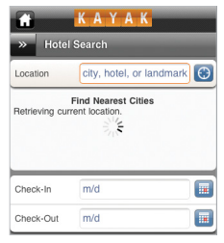
Location services
Notes:
An example of simplifying the user interface to pre-populate fields based on the native GPS location services. Kayak can find the nearest hotels based on your current location without unnecessary taps and keyboard inputs.

Slide 8
Location Services
Carrier Towers (Accuracy within ~1000m+)
WiFI Signal (Accuracy within ~200m)
GPS (Accuracy within ~10m)
*Expect more accurate GPS location soon!
http://www.ted.com/talks/todd_humphreys_how_to_fool_a_gps.html

Slide 9
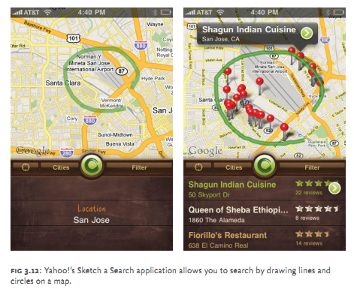
Custom Map Interactions
Notes:
Yahoo Maps has very creatively created a simple interface for locating points of interest on a Map based on the user’s location. Rather than fumbling with a keyboard input, a user can simply draw any shape around an area of the map they are interested in and get all points of interest located within that drawn shape. You can glean a lot of information about an area with one swipe of the thumb.

Slide 10
Custom Map Interactions
Put Framework example here
Notes:
Yahoo Maps has very creatively created a simple interface for locating points of interest on a Map based on the user’s location. Rather than fumbling with a keyboard input, a user can simply draw any shape around an area of the map they are interested in and get all points of interest located within that drawn shape. You can glean a lot of information about an area with one swipe of the thumb.

Slide 11
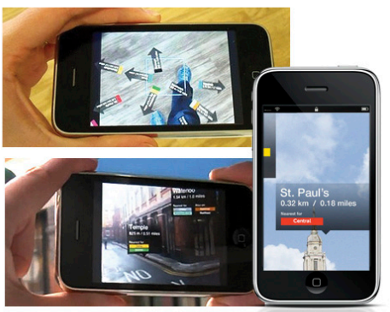
Augmented Reality
Notes:
The London Underground has developed a Camera Overlay that makes use of your location Data via GPS services. It will overlay arrows pointing to the nearest stations via your camera display. This is an incredibly inventive way to direct users to the nearest station while also giving them insight into the Line the subway operates on.
Useful Libraries
http://code.google.com/p/andar/
https://developer.qualcomm.com/mobile-development/mobile-technologies/augmented-reality

Slide 12
Augmented Reality
Kitsch or the future?
Google Glasses and First Person UI’s
https://github.com/zac/iphonearkit/
https://github.com/haseman/Android-AR-Kit
https://developer.qualcomm.com/mobile-development/mobile-technologies/augmented-reality
http://www.lukew.com/presos/preso.asp?21

Slide 13
Haptic Feedback
Heighten the User Experience
Just for games?
Android and Windows Phone only. Apple soon?
http://www.immersion.com/developers/
Notes:
Used mostly for games, but think about using it for your buttons or environment interactions.

Slide 14
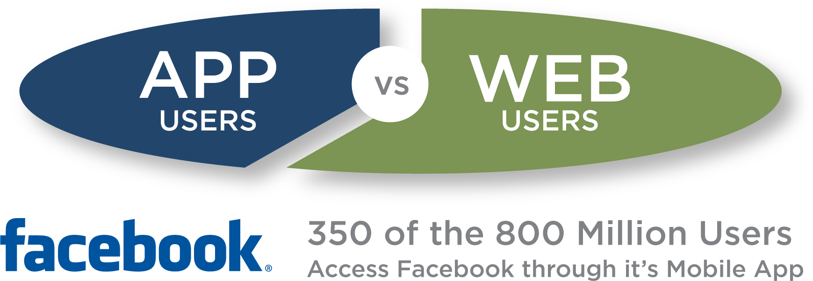
Becoming the preferred experience
source: http://www.facebook.com/press/info.php?statistics
Notes:
Mobile is currently an extension of your application. This may not be true in the future. It is quickly becoming the preferred user experience. Facebook already recognizes this and has already invested heavily in focusing their entire platform on mobile.
Facebook app
More than 800 million active users, 350 million through the Mobile App (insert diagram BK)

Slide 15
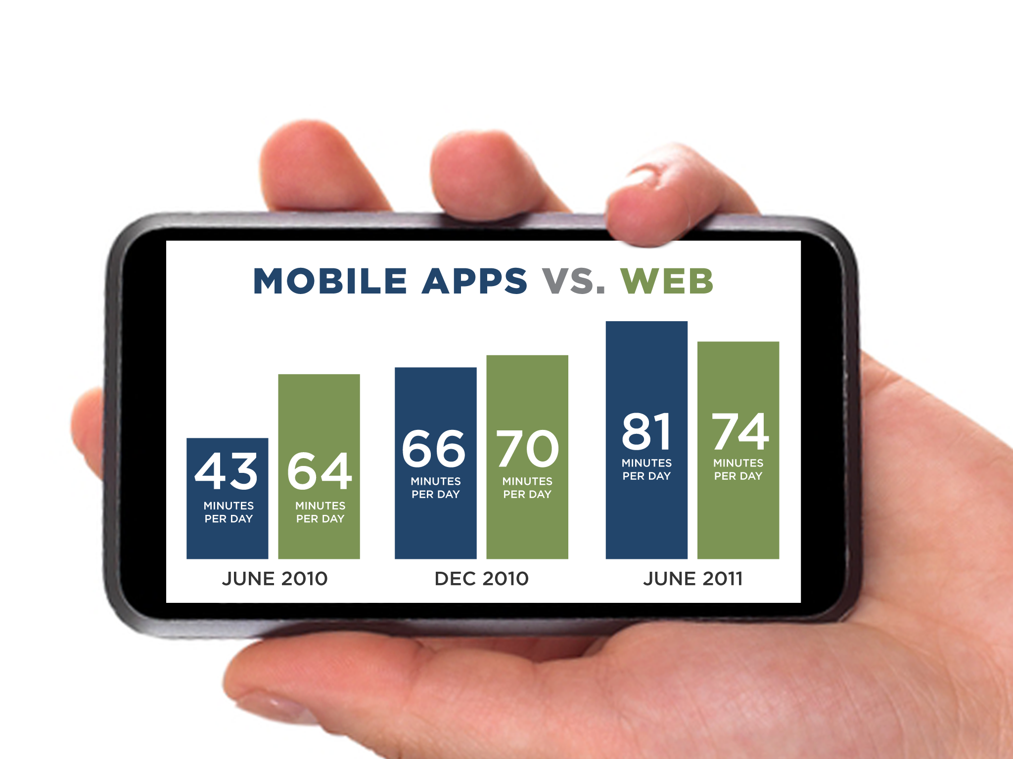
sources: comScore, Alexa, Flurry Analytics
Notes:
More applications will be developed for the Mobile web than PCs.
There are 1.3 million mobile apps today, versus 50,000 to 75,000 PC applications,
Mobile is quickly becoming the preferred choice among users.

Slide 16
What have we learned?
Mobile is totally awesomesauce.
It’s likely not a fad.
Mobile is a dizzying and rapidly evolving platform that is changing how users interact with each other and the world around them.
Mobile Devices are rapidly expanding into our lives and the market has taken notice.
Notes:
Mobile Devices are changing the way we develop. Mobile use may usurp desktop/laptop use as the preferred experience.
Applications are no longer monolithic apps that do everything. Applications are now smaller, hyper focused and unchained by location.
In mobile, the application is the sum of all its parts and those parts are the hyper focused individual apps.
Future development may sidestep the large desktop experience with mobile as the augmenter, to a Mobile first approach.
How do we evolve to a new development landscape that requires rapidly deploying smaller plank applications?

Slide 17
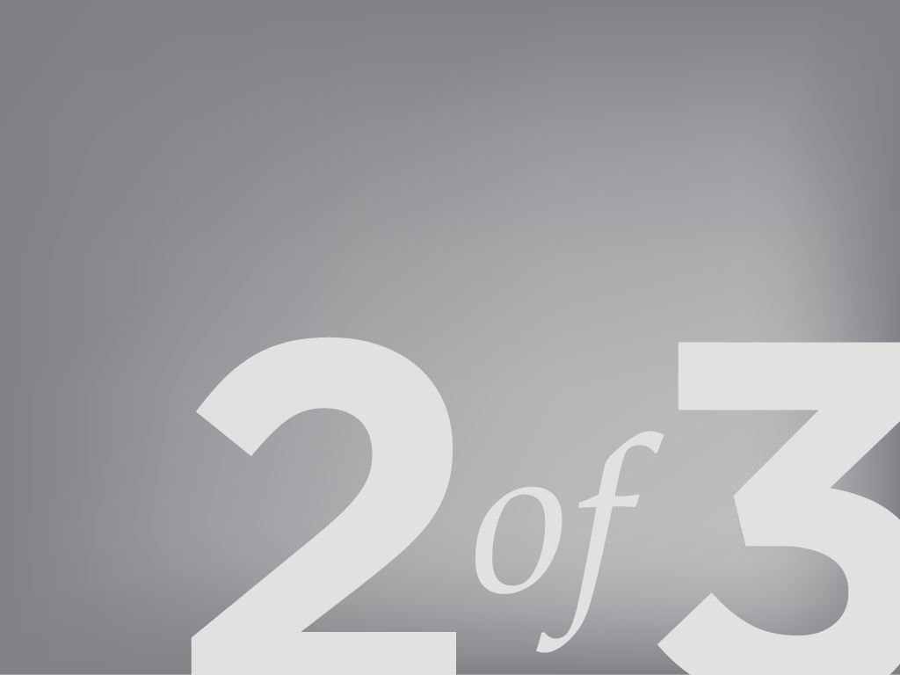
Mobile is Different and the Same
“…I have always found that plans are useless, but planning is indispensable.”
- Dwight D. Eisenhower

Slide 18
Focused Domain
“One Eye, One Thumb”
Hyper Focused Content/Functionality
Increased efficiency
Leverage Mobile sensors to streamline the user experience
Notes:
A mobile app is not as simple as porting your enterprise application on a mobile device. A mobile device provides a totally different user experience that requires you to boil down your content and functionality to it’s basest components. Mobile users use mobile apps in completely different way. Being mobile means that there are environmental factors that split the user’s focus. When developing on mobile, you need to be aware of these environmental distractions and plan for your user to only be using one eye and one thumb.

Slide 19
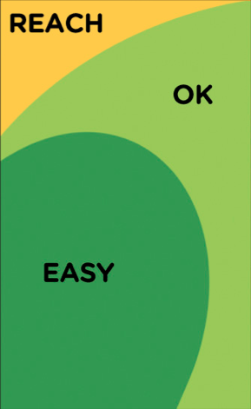
“One Eye, One Thumb”
Notes:
A mobile app is not as simple as porting your enterprise application on a mobile device. A mobile device provides a totally different user experience that requires you to boil down your content and functionality to it’s basest components. Mobile users use mobile apps in completely different way. Being mobile means that there are environmental factors that split the user’s focus. When developing on mobile, you need to be aware of these environmental distractions and plan for your user to only be using one eye and one thumb.

Slide 20
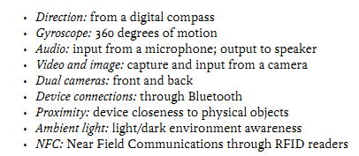
New Ways to Interact
No longer limited to clicks and key presses.
Reduce 20 clicks to a gesture, swipe, tilt, point, shoot, speak, bump, touch, feel, notification, push, pull, bump, beam
Notes:
The Native capabilities of mobile devices opens up a whole slew of new interactions. New functionality on the horizon is ambient light detection and NFC.

Slide 21
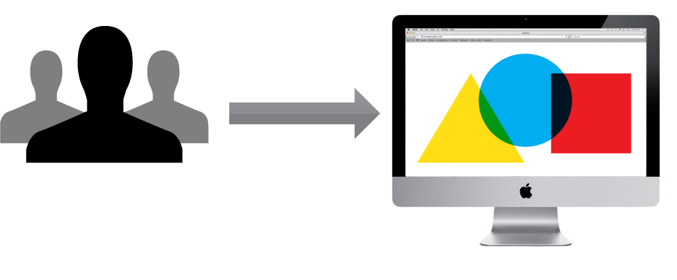
Enterprise Web Application
Notes:
Your Typical web application needs to do many things and fit many users. It involves planning, understanding user needs, large timelines & development teams to satisfy this.

Slide 22
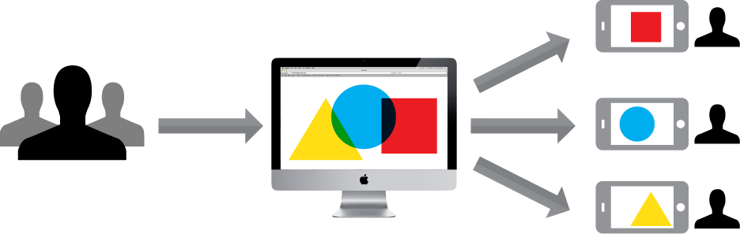
Web Application vs. Mobile Apps
Notes:
An App seeks not to do everything, but focus on just what the each user actually needs. The total sum of all mobile applications is the whole enterprise application with a tailored user experiences.

Slide 23
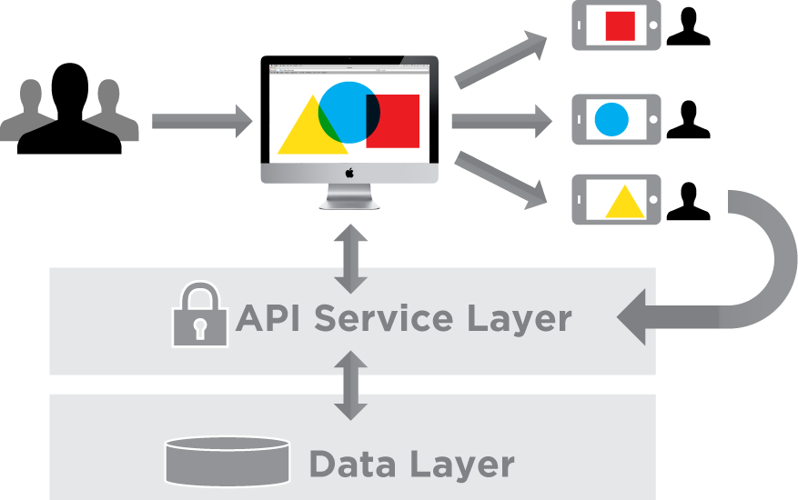
Same Architecture, Different focus.
Notes:
Apps connect the same way applications do. They can use the same web security to access Services, Databases & information as a web application. In this manner, your Domain Focused mobile applications extend you web application in new and personalized ways.

Slide 24
When designing for mobile
Focus & prioritize the services
Innovate the user experience
Start thinking differently:
Continuously reduce domain per application
Content organization – what’s important
New user interactions
Pre-populate information (AKA Location from GPS)
The user’s external environment is your friend (and your enemy)
Notes:
Embrace mobile constraints to focus and prioritize the services we’re designing and building.
Use mobile capabilities to innovate the complete customer experience.
Take what we know about designing for the web and start thinking differently about mobile organization, actions, inputs, and layout.

Slide 25
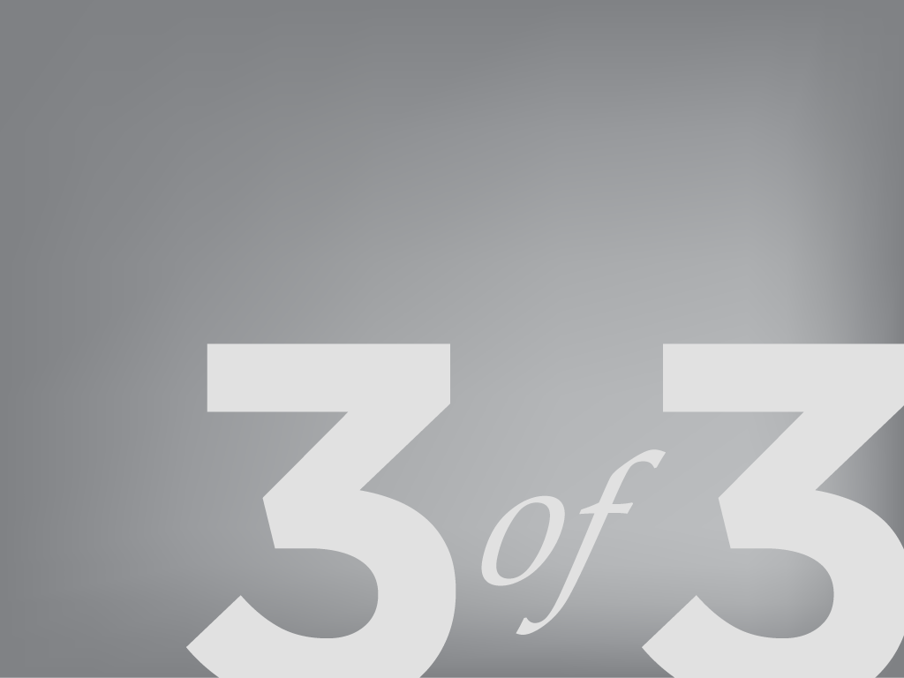
Mobile Development Strategies
So mobile is great and all… but where do I start?
Notes:
Engaged employees are the creative force behind everything good that happens in an organization.
http://gmj.gallup.com/content/150710/High-Energy-Workplaces-Save-America.aspx?utm_source=email&utm_medium=012012&utm_content=titlelink&utm_campaign=newsletter#2

Slide 26
The Landscape
There are several strategies available.
We’ll break down the 4 most common strategies
Pure Mobile Web
Pure Native
Mobile Web Apps
Hybrid Apps

Slide 27
Mobile Web
Responsive Web Design (will blow your mind)
Leverage CSS3 @Media Queries
Build site that can conform to multiple devices and resolutions
Build your site’s styles for mobile devices FIRST, then extend your styles for the desktop.
You MUST read Responsive Web Design and Mobile First!!

Slide 28
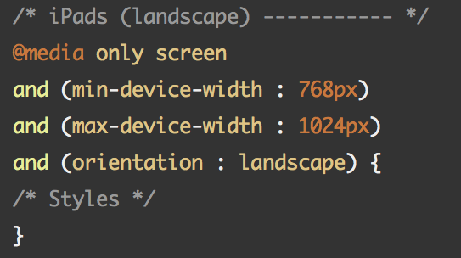
@Media Query

Slide 29
Mobile Web
Pros
Your site or web application is optimized for ALL devices and desktop resolutions
You’ll get a TON of street cred
Can become a standalone Native app through Web Views (will explain later)
Basic location services
No need to download or version

Slide 30
Mobile Web
Cons
Your site or web application is optimized for ALL devices and desktop resolutions (not a typo)
No Native Capabilities
Cannot, by itself, be a downloadable app
Harder to monetize

Slide 31
Mobile Web Examples
gmail.com
twitter.com
bostonglobe.com
starbucks.com
dreamforce.com (seriously check this one out)
Check out Twitter Bootstrap for your sites!

Slide 32
Native Apps
Pros
Leverage the entirety of a devices capabilities
Easier to monetize
Smoothest User Experience
Most immersive User Experience
Background Services
Push Notifications
Widgets
OpenGL!!!
So much cooler (from an Engineer’s perspective)

Slide 33
Native Apps
Cons
Shallow talent pool of developers
4 platforms, 4 development efforts
Longer development time (sometimes)
Expensive
No OpenGL but hopefully WebGL through the HTML5 canvas soon.

Slide 34
Native Apps
Almost every mobile game out there
Most apps

Slide 35
Mobile Web App Frameworks
Phone Gap (now Apache Cordova)
Pros
Opens up a serious subset of Native capabilities
Deeper Talent Pool
Much quicker development time
Leverages HTML5, CSS3 and JavaScript
4 platforms, 1 development effort
Easier Maintenance
Open Source

Slide 36
Mobile Web App Frameworks
Phone Gap (now Apache Cordova)
Cons
Not all sensors are represented
Not as smooth as Native
Effort required to make it not look like a Phone Gap app
Does not play well with Native Code
iOS : No Core Data ☹

Slide 37
Other Mobile Web App Frameworks
jQuery Mobile
Awesome, free and Open Source
Appcelerator’s Titanium
Pretty cool, but proprietary and expensive
Sencha Touch
Also pretty cool. Cheaper alternative to Titanium.
Free for up to 5000 users.
Tiggzi
Hella cool cloud-based mobile web app IDE
Uses Apache Cordova (PhoneGap)

Slide 38
Mobile Web Apps
Wikipedia
Untappd
BBC Olympics
HealthTap

Slide 39
Hybrid Apps
Still native, but makes use of Web Views
Pros
Get your native on
Your dynamic content

Slide 40
Hybrid Apps
Still native, but makes use of Web Views
Pros
Get your native on
Web Views can re-leverage your web content
Flexible

Slide 41
Hybrid App Examples
Flipboard
Instagram
LinkedIn
Facebook
Yelp

Slide 42
To conclude…
Mobile use may soon usurp desktop/laptop use as the preferred experience.
Future development may sidestep the large desktop experience with mobile as the augmenter, to a Mobile first approach.
Mobile Devices are changing the way we develop.
There are many ways to develop for mobile, but let your application requirements be your guide.
Notes:
Mobile Devices are changing the way we develop. Mobile use may usurp desktop/laptop use as the preferred experience.
Applications are no longer monolithic apps that do everything. Applications are now smaller, hyper focused and unchained by location.
In mobile, the application is the sum of all its parts and those parts are the hyper focused individual apps.
Future development may sidestep the large desktop experience with mobile as the augmenter, to a Mobile first approach.
How do we evolve to a new development landscape that requires rapidly deploying smaller plank applications?

Slide 43
A Quick Plug for SPARC
SPARC
We build AWESOME stuffs
3 Flavors - Commercial, Federal/Defense and Product Development
85% of us are Engineers
Come follow the talent!
http://www.sparcedge.com/careers/working-at-sparc/
Notes:
Mobile Devices are changing the way we develop. Mobile use may usurp desktop/laptop use as the preferred experience.
Applications are no longer monolithic apps that do everything. Applications are now smaller, hyper focused and unchained by location.
In mobile, the application is the sum of all its parts and those parts are the hyper focused individual apps.
Future development may sidestep the large desktop experience with mobile as the augmenter, to a Mobile first approach.
How do we evolve to a new development landscape that requires rapidly deploying smaller plank applications?

Slide 44
Questions?
Presentation materials URL
Code Stuffs URL
Notes:
Mobile Devices are changing the way we develop. Mobile use may usurp desktop/laptop use as the preferred experience.
Applications are no longer monolithic apps that do everything. Applications are now smaller, hyper focused and unchained by location.
In mobile, the application is the sum of all its parts and those parts are the hyper focused individual apps.
Future development may sidestep the large desktop experience with mobile as the augmenter, to a Mobile first approach.
How do we evolve to a new development landscape that requires rapidly deploying smaller plank applications?

